Slide 1


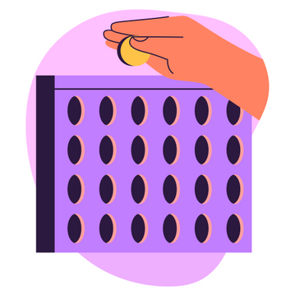
Let’s Play
Connect 4
START!
Under The Supervision Of
Dr/ Mohamed Rehan

Slide 2
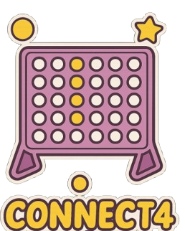
table of conteNts
Problem Formulation
1
Technical Discussion
2
Results
3
Task Assignment
4

Slide 3
From Childhood Game
to AI Challenge
What is connect 4?
how to play
Why It’s Perfect for AI:
A classic vertical strategy game where two players take turns dropping colored discs into a 7x6 grid.
Goal: Be the first to connect four discs in a row (horizontally, vertically, or diagonally).
Simple Rules, Complex Strategy
Turn-Based Adversarial Play
Instant Feedback

Slide 4
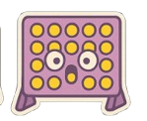
Problem Formulation
01
Initial State
04
Goal Test
an empty 6×7 grid
Two players take turns
Four of the same colour discs aligned:
Horizontally
Vertically
Diagonally (either direction)
03
Transition Model
02
Actions
Places the current player's disc in the lowest available row of the selected column.
Updates the game board.
Switches the turn to the next player.
Legal Moves
(A player selects one of the 7 columns to drop a disc into)
(The disc falls to the lowest available row in the chosen column.)
Invalid Moves
(Choosing a column that is already full)
05
Path Cost
The number of moves made from the initial state to reach a terminal state.
defining separate evaluation metrics

Slide 5
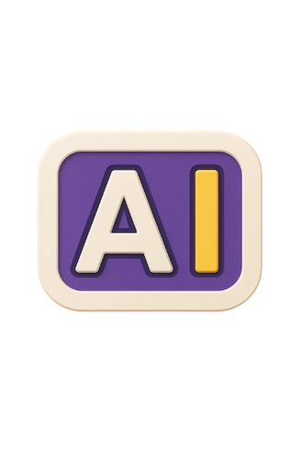
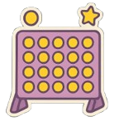
The Playbook
MINIMAX
ALPHA-BETA
I-D ALPHA BETA

Slide 6
MINIMAX

Slide 7

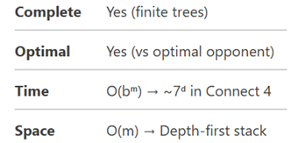
The AI's Strategic Brain for Connect 4
Foundational decision-making
Assumes optimal play from both AI (maximizing wins) and opponent (minimizing AI's advantage
Systematically evaluates future game states
Minimax Algorithm
Alternates between maximizing (AI's turn) and minimizing (opponent's turn) perspectives
Maximizer (AI): Selects the move with the highest evaluation (optimal play).
(Opponent): Chooses the move with the lowest evaluation (best counterplay).

Slide 8

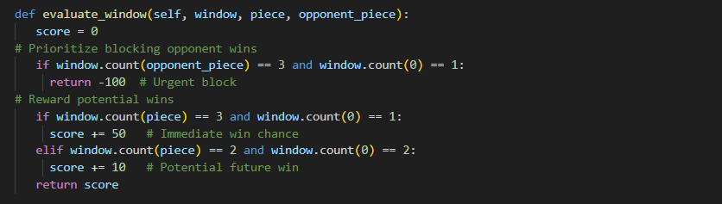


score board

Slide 9
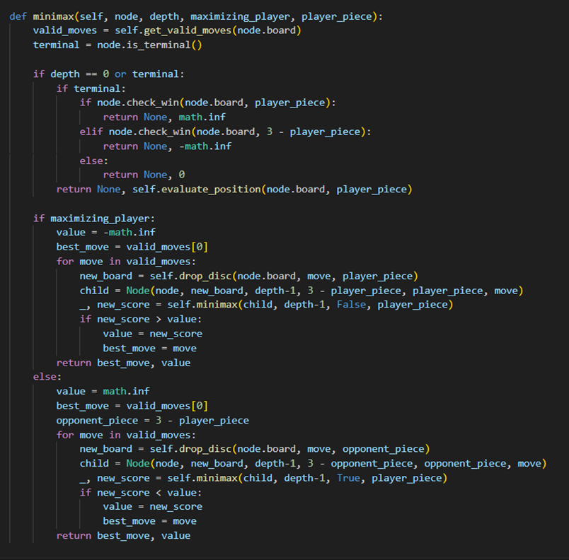

Slide 10

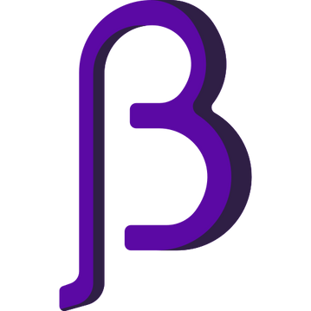
alpha-beta

Slide 11
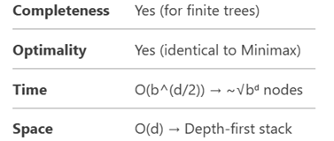
RECURSIVE EVALUATION PROCESS
Maximizing Player (AI’s Turn)
Minimizing Player (Opponent’s Turn)
Updates Alpha: Tracks the best score AI can guarantee.
Prunes if: Current value ≥ Beta
Early Return: If Alpha ≥ Beta .
Updates Beta: Tracks the best score opponent can force.
Prunes if: Current value ≤ Alpha (AI’s best alternative).
Early Return: If Beta ≤ Alpha (no worse move exists).

Slide 12
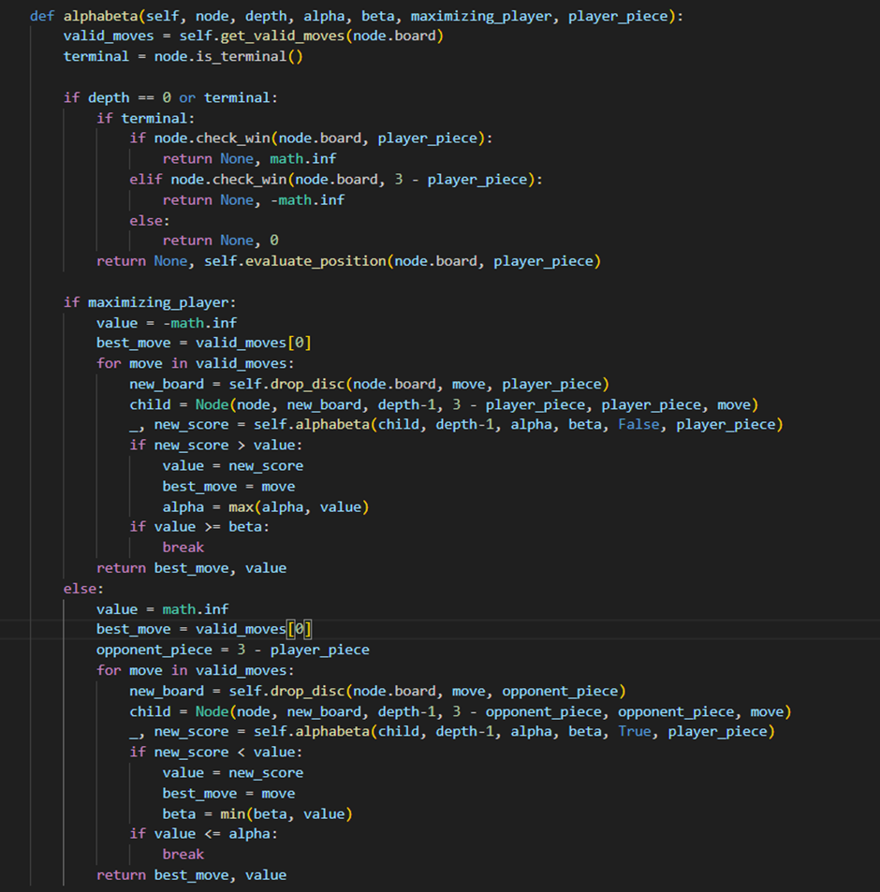

Slide 13

ITERATIVE DEEPING alpha-beta

Slide 14
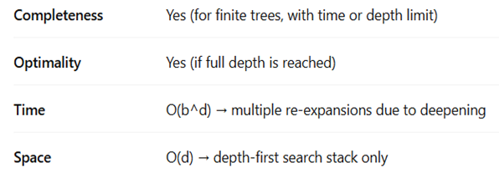
RECURSIVE EVALUATION PROCESS
Synergy with Alpha-Beta
Retains all benefits of Alpha-Beta (optimality, branch pruning).
Earlier iterations "warm up" the search by identifying strong moves first.
Progressive Depth Search
Runs Alpha-Beta repeatedly from depth=1 to max_depth (default: 10).
Each iteration refines move ordering, improving pruning efficiency in deeper searches.

Slide 15
results

Slide 16
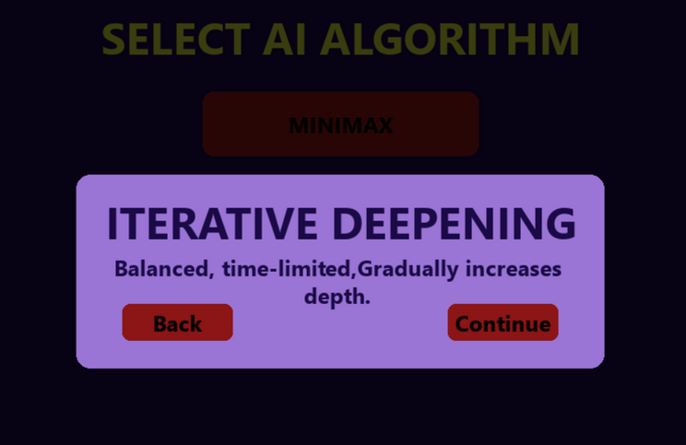
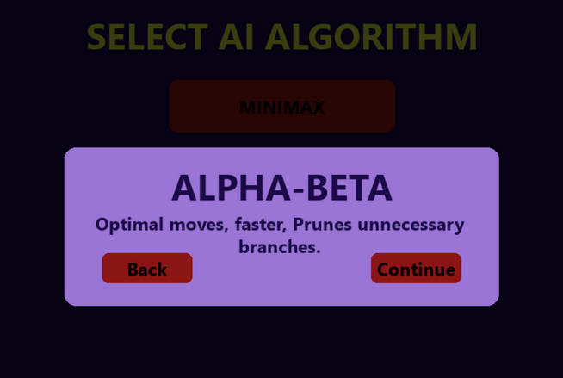
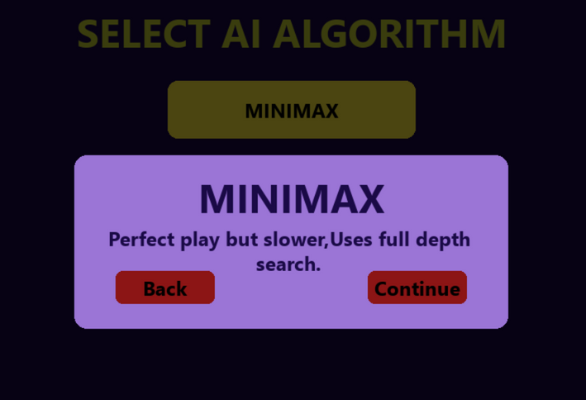
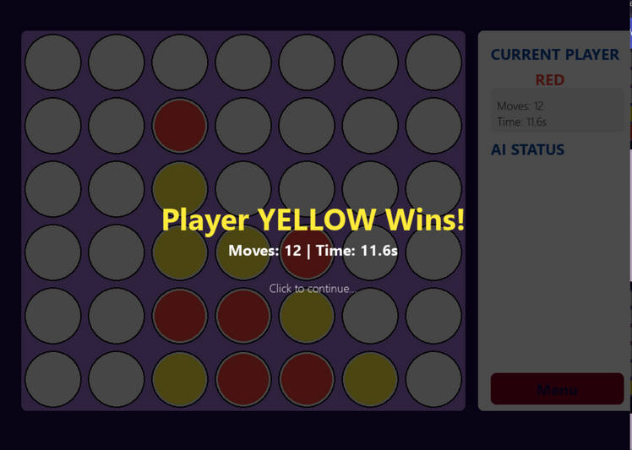
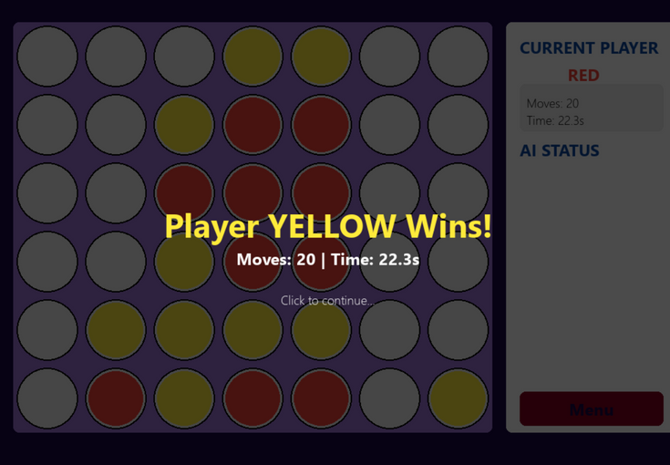
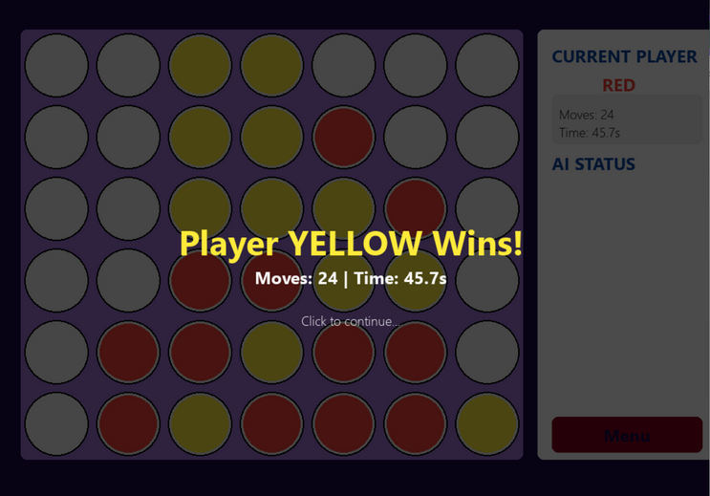

Slide 17

Our Team
1
Malak Mounir Abdellatif 231903643
2
Razan Ahmed Fawzy 221903165
3
Farida Waheed Abdelbary 221903168
4
Nour Hesham El-Sayed 221902960
5
Nourhan Farag Mohamed 231903707

Slide 18

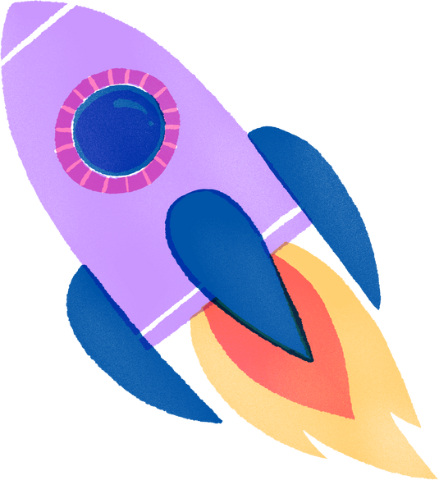
Thank’s for playing
ANY QUESTIONS?

